Slide 1
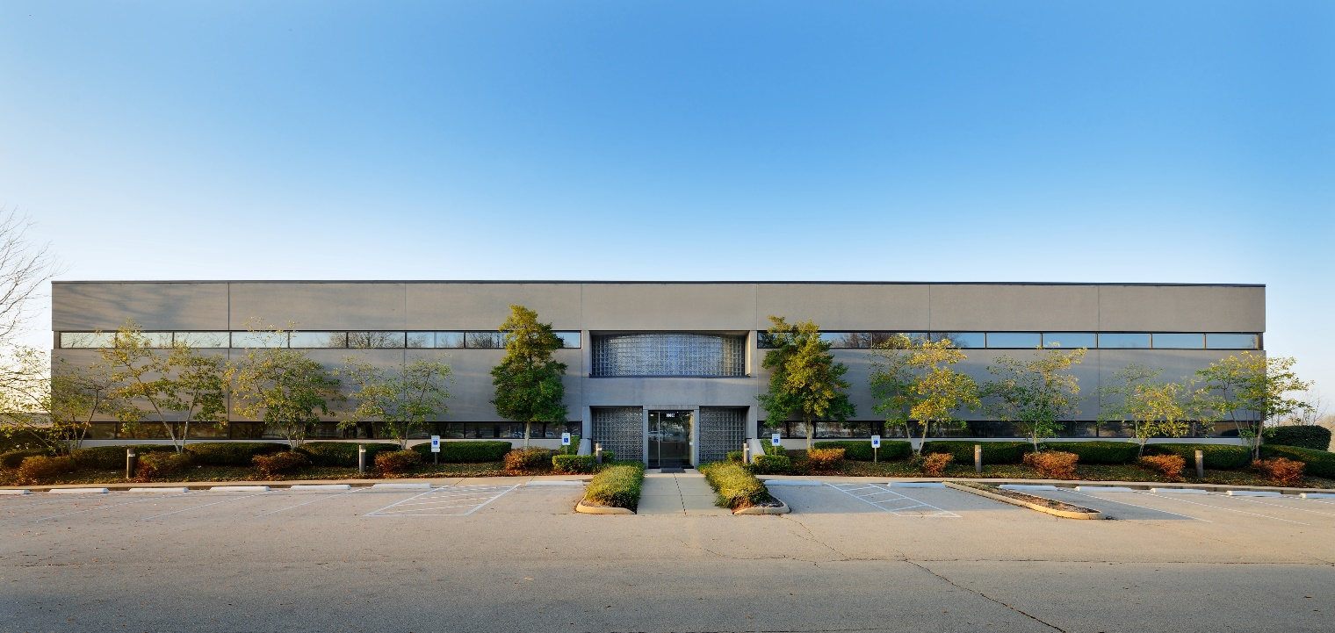
OFFERING SUMMARY
2008 Mercer Road
2008 Mercer Road, Lexington, KY 40511

Slide 2
OFFERING SUMMARY
OFFERING
Coleman Group, on behalf of the building owner, is pleased to offer for sale the R&D building located in Lexington, Kentucky. The building contains 41,450 square feet and is located on a 3.25 Acres parcel.
PROPERTY HIGHLIGHTS
Key Property Facts
Land Area: | 3.25 Acres
Attached Parking: | 164
Zoning: | I-1 Light Industrial
Leasing: | Coleman Group
Class A office building
Located a few minutes from downtown, the airport, I-64/I-75, and a few blocks from New Circle Road
Close proximity to mixed use developments with abundant amenities:
Manufacturing
Office Properties
Retail
Restaurants
Banking
Residential
Financial Information
Asking Price: | $4,950,000
Sale Terms: | Cash
Sale Conditions: | “As Is, Where Is.”
Effective Gross Income: | $298,037
Total Expenses: | $152,840
2016 NOI: | $145,196
Cap Rate: | 8.33
INVESTMENT HIGHLIGHTS
Perfect opportunity for a owner occupant.
Top Floor 16,660 + Ground level 8,330 available for owner to utilize, while still having long term tenant
Current Tenant Commonwealth of Kentucky lease expires 12/31/31
Located near Amazon, UPS, FedEx, Columbia Gas
Quality construction of building
Property Overview
Year Built: | 1998
Gross Building: | 41,650 S.F.
Stories: | 3
Lower Level: First Floor: Second Floor: | 8,330 S.F. 16,660 S.F. 16,660 S.F.
Contact
Vickey Strunk
895.255.8855

Slide 3
OFFERING PROCESS
Offers are being sought for the purchase of 2008 Mercer Road on an “As Is, Where Is” basis to qualified office investors. The prospective purchaser will be selected by the Owner on the basis of: (a) price, (b) financial strength, (c) level of discretion to invest funds, and (d) experience in closing similar retail transactions.
Property tours are now available.
For further information
please contact:
Vickey Strunk
Broker
Coleman Group
710 East Main Street Suite 130
Lexington, KY 40502
Phone: 859-255-8855
Mobile: 859-582-8092
vstrunk@colemangroup.net

